Slide 1
Constraint Satisfaction
Problems

Slide 2
Introduction
Many of the real world problems demand the solution to satisfy a set of algebraic or logical conditions, called constraints.
Formally speaking, a constraint satisfaction problem (or CSP) is defined by a set of variables, X₁, X₂, . . . , X_{n}, and a set of constraints, C₁, C₂, . . . , C_{m}. Each variable X_{i} has a nonempty domain D_{i} of possible values.
An assignment that does not violate any constraints is called a consistent or legal CONSISTENT assignment.
A complete assignment is one in which every variable is mentioned, and a solution to a CSP is a complete assignment that satisfies all the constraints.

Slide 3
Examples
The class of problems, whose search space is constrained by a set of conditions, is generally referred to as ‘Constraint Satisfaction Problems (CSP)’
Linear optimization problems where we want to maximize Z= Σc_{i}x_{i} subject to a set of linear constraints of the form: Σ a_{i}x_{i} ≤ b, for instance, is a CSP.
Many formulations of the problems, however, require satisfying logical or geometric constraints.
For example, finding the grand-fatherhood relationship between X₃ (=d) and X₁ (=l) from the definition of grandfather and father, discussed below, is a CSP.

Slide 4
Examples
Suppose, given the following set of constraints:
1.Grandfather (X₃,X₁) :- Father (X₂,X₁), Father (X₃,X₂).
2. Father (d, r).
3. Father (r, l).
We want to determine: Grandfather (X₃, X₁) ?
Problems that deal with such logical constraints also belong to the category of CSP.

Slide 5
Constraints
A primitive constraint comprises of one or more constraint relation symbols together with their arguments, but cannot have a conjunction (Λ) in it. For example, x ≤2 , (x +y ) ≤ 2 are primitive constraints
A non-primitive or generic constraint is a conjunction (Λ) of primitive constraints. For example, (x+ y ≤ 2) Λ ( y ≤ 3 ) is a non-primitive constraint.
A constraint is called satisfiable, if there exists at least one solution satisfying the constraint. For instance, {(x+ y ≤2 ) ∧ ( 0 ≤x, y ≤2 ) } are satisfiable constraints for integer x, y as there exists a solution x = y =1 that satisfies the constraints.

Slide 6
Constraints
The simplest type of constraint is the unary constraint, which restricts the value of a single variable.
A binary constraint relates two variables.
A binary CSP is one with only binary constraints; it can be represented as a constraint graph
Constraint graph for binary CSP problem is an undirected graph, where:
– Nodes are variables
– Links/ edges represent the constraints

Slide 7


Example: 4 Queens
Variables: Q_{i,} associated with each row of 4 x 4 board
Domains: D_{i} = {1, 2, 3, 4}
Constraints: Q_{i} ≠ Q_{j} (cannot be in same row) and |Q_{i} – Q_{j}| ≠ |i - j| (or same diagonal)
Valid values for (Q₁, Q₂) are (1,3) (1,4) (2,4) (3,1) (4,1)(4,2)
Q₁
Q₂ Q₃
Q₄

Slide 8
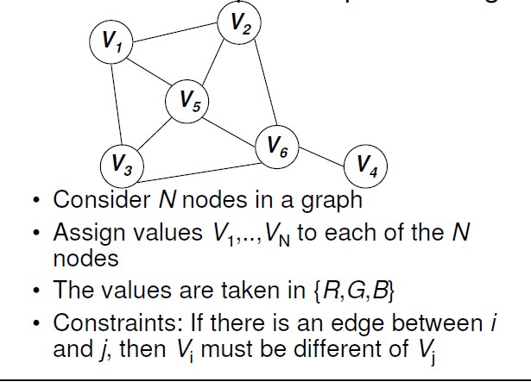
Example: Graph Coloring

Slide 9
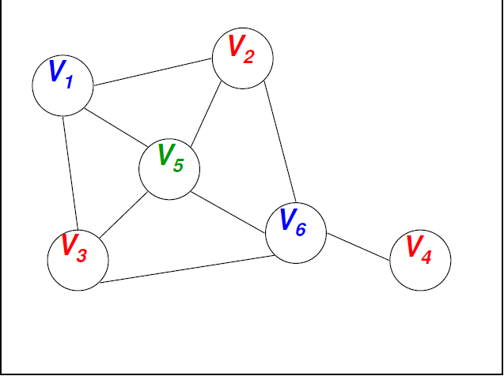
Example: Graph Coloring

Slide 10
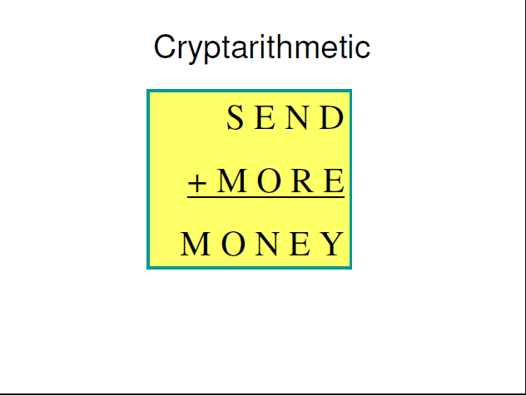
Example

Slide 11
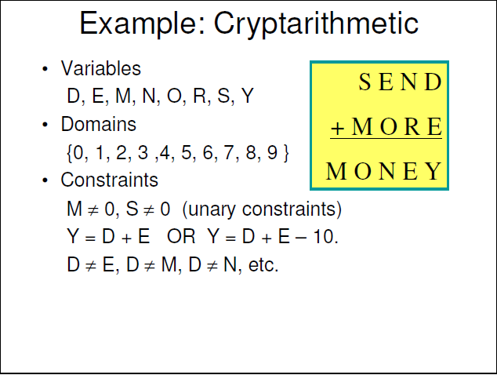

Slide 12
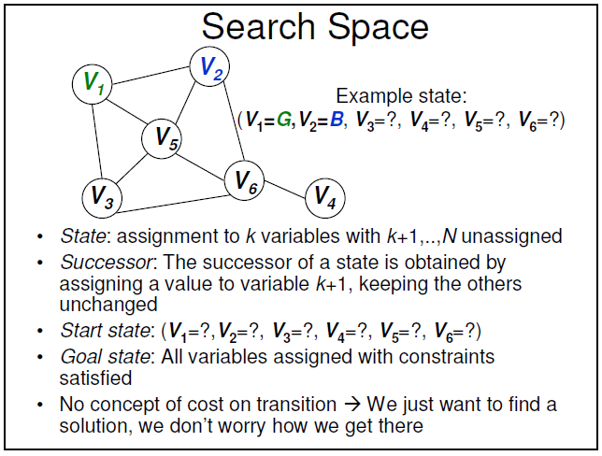
Depth-First-Search

Slide 13
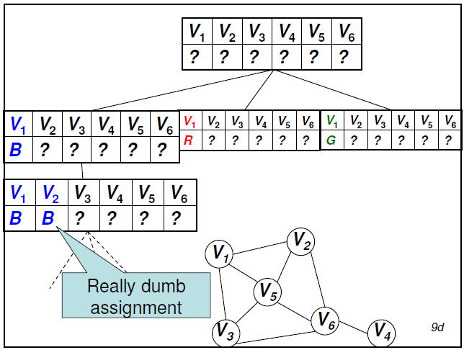
Depth-First-Search
Recursively:
• For every possible value in D:
• Set the next unassigned variable in the successor to that value
• Evaluate the successor of the current state with this variable assignment
• Stop as soon as a solution is found

Slide 14
Depth-First-Search
Improvements:
–Evaluate only value assignments that do not violate any constraints with the current assignments
–Don’t search branches that obviously cannot lead to a solution
–Predict valid assignments ahead
–Control order of variables and values

Slide 15
Backtracking Search For CSPs
The term backtracking search is used for a depth-first search that chooses values for one variable at a time and backtracks when a variable has no legal values left to assign
Special property of CSPs: They are commutative. This means: the order in which we assign variables does not matter.
Search tree: First order variables, then assign them values one-by-one.

Slide 16
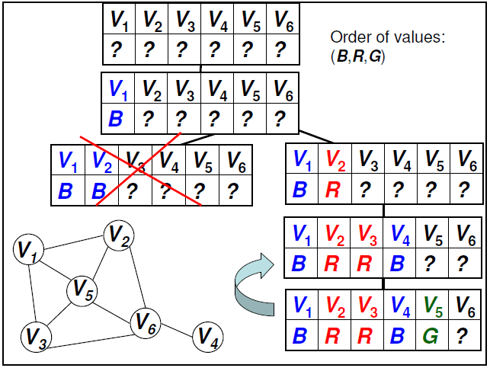
Backtracking

Slide 17
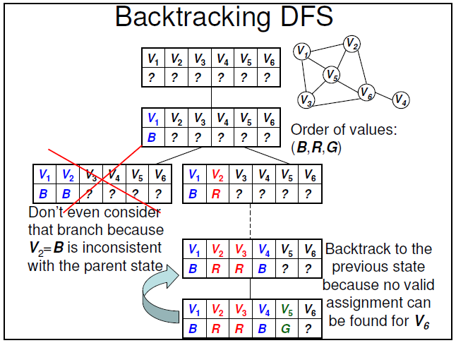

Slide 18
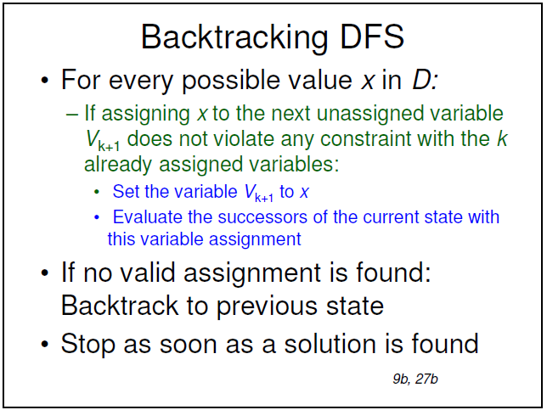

Slide 19
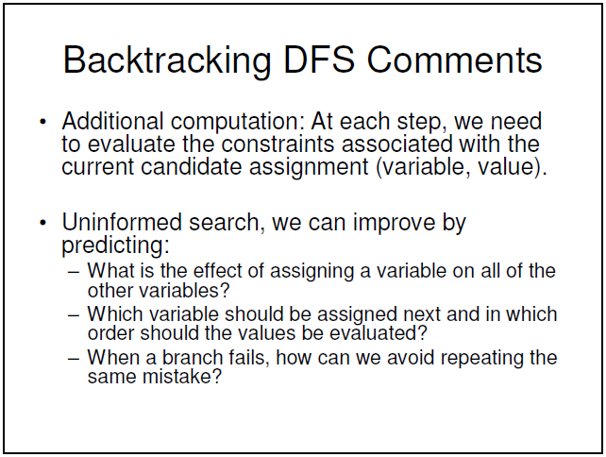

Slide 20
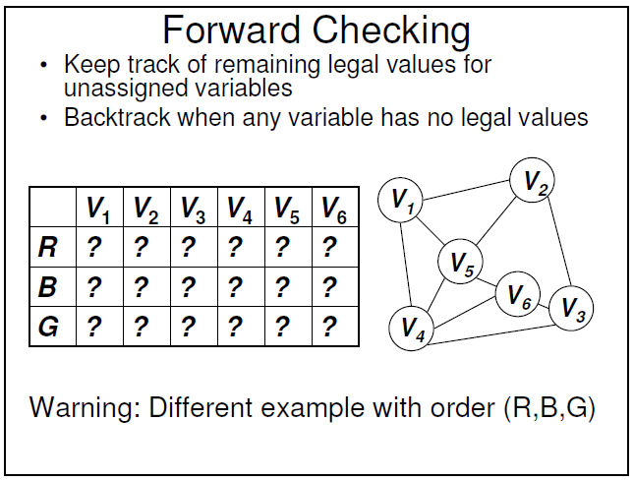

Slide 21
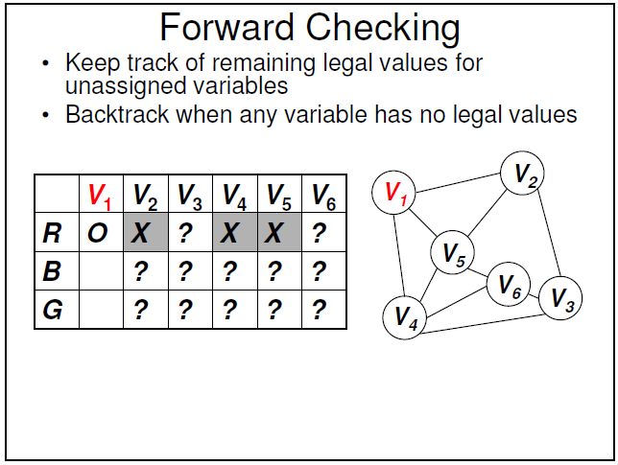

Slide 22
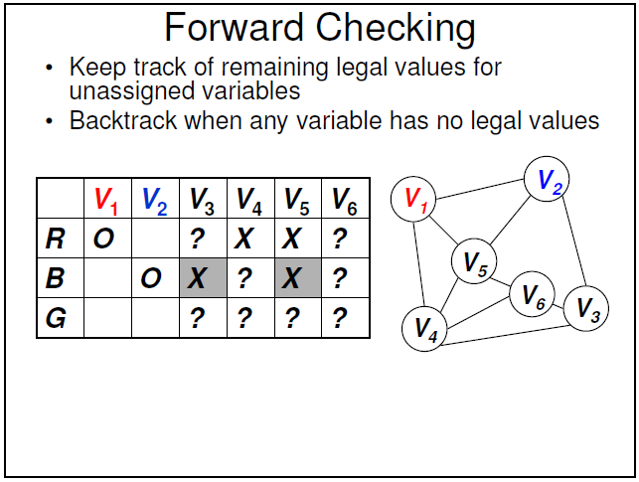

Slide 23
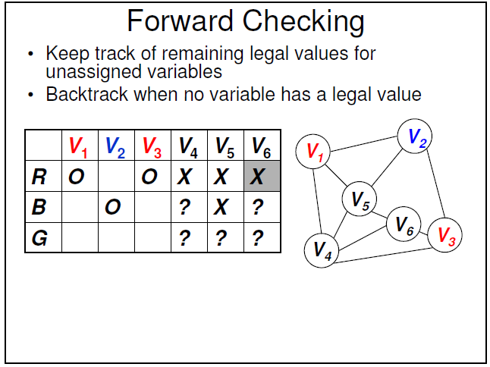

Slide 24
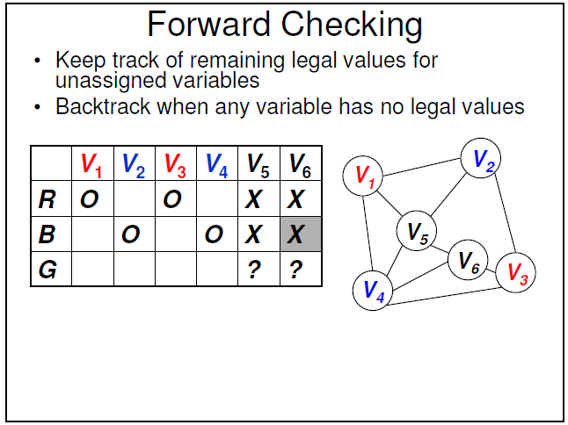

Slide 25
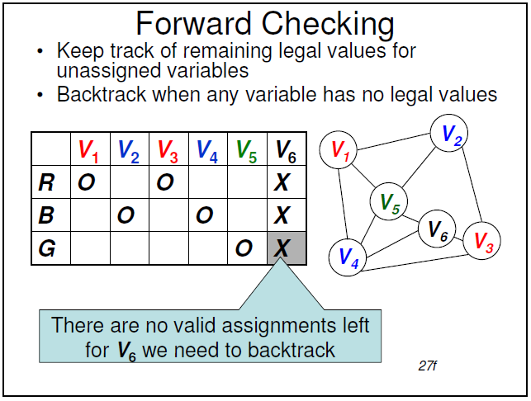

Slide 26
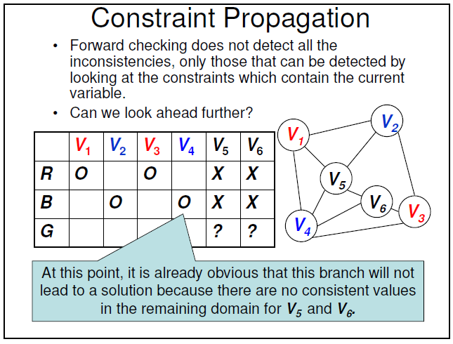

Slide 27
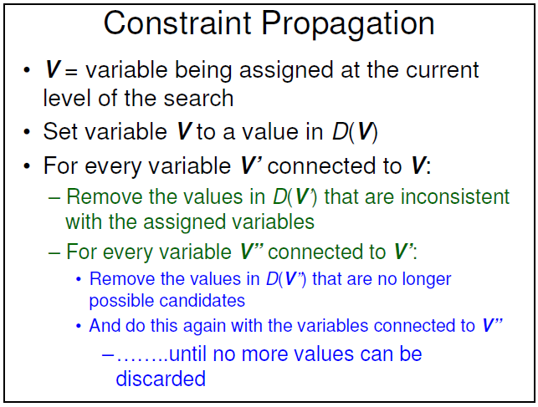

Slide 28
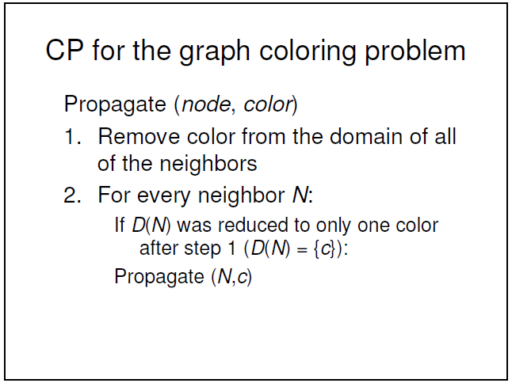

Slide 29
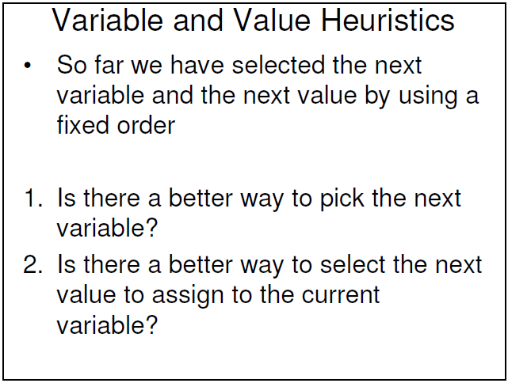

Slide 30
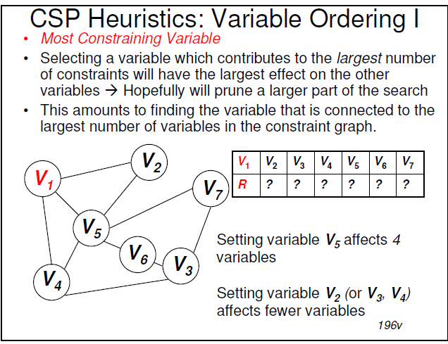

Slide 31
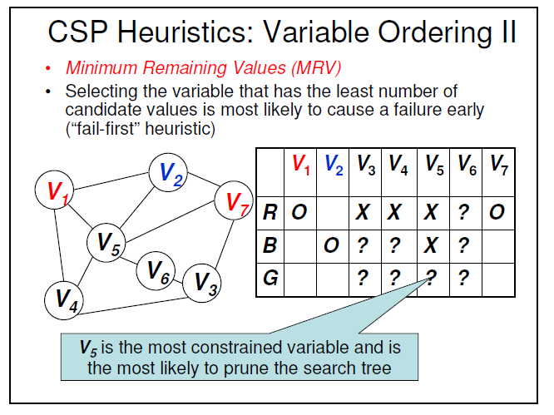

Slide 32
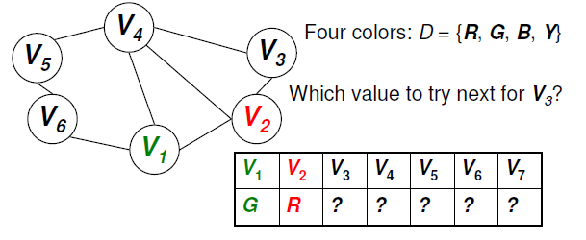
CSP Heuristics: Value Ordering
Least Constraining Value
Choose the value which causes the smallest reduction in the number of available values for the neighboring variables

Slide 33
Backtracking: 4 Queens Problem
Variables: Q_{i,} associated with each row of 4 x 4 board
Domains: D_{i} = {1, 2, 3, 4}
Constraints: Q_{i}≠Q_{j} (cannot be in same column) and |Q_{i} – Q_{j}| ≠ |i - j| (or same diagonal)
Q₁ | Q₂ | Q₃ | Q₄
1 | ? | ? | ?
Q₁ | Q₂ | Q₃ | Q₄
1 | 4 | ? | ?
Q₁ | Q₂ | Q₃ | Q₄
1 | 3 | ? | ?
Q₁ | Q₂ | Q₃ | Q₄
1 | 4 | 2 | ?
Q₁ | Q₂ | Q₃ | Q₄
1 | 3 | No value possible | ?

Slide 34
Backtracking: 4 Queens Problem
Q₁ | Q₂ | Q₃ | Q₄
2
Q₁ | Q₂ | Q₃ | Q₄
2 | 4
Q₁ | Q₂ | Q₃ | Q₄
2 | 4 | 1
Q₁ | Q₂ | Q₃ | Q₄
2 | 4 | 1 | 3

Slide 35
Example: A Crossword Puzzle
 | 1 | 2 | 3 | 4 | 5
1 | 1 |  | 2 |  | 3
2 | # | # |  | #
3 | # | 4 |  | 5
4 | 6 | # | 7
5 | 8
6 | # | # |  |  | #
List of words Given as follows:
AFT KEEL SHEET
ALE KNOT STEER
EEL LASER TIE
HEEL LEE
HIKE LINE
HOSES SAILS

Slide 36
Example: A Crossword Puzzle
Formulation of the problem as a CSP
Variable | Starting Cell | Domain
1ACROSS | 1 | HOSES, LASER, SAILS, SHEET, STEER
4ACROSS | 4 | HEEL, HIKE, KEEL, KNOT, LINE
7ACROSS | 7 | AFT, ALE, EEL, LEE, TIE
8ACROSS | 8 | HOSES, LASER, SAILS, SHEET, STEER
2DOWN | 2 | HOSES, LASER, SAILS, SHEET, STEER
3DOWN | 3 | HOSES, LASER, SAILS, SHEET, STEER
5DOWN | 5 | HEEL, HIKE, KEEL, KNOT, LINE
6DOWN | 6 | AFT, ALE, EEL, LEE, TIE

Slide 37
Example: A Crossword Puzzle
Constraint Graph of the problem:
1A 2D 4A
3D
7A 5D 8A
6D

